Slide 1

NETFLIX
Analysis of Netflix India’s YouTube Channel Designed by Devika Suresh Social Media Analytics Team @ AtliQ Technologies

Slide 2
Insights
Consistency is good — but spikes matter more Netflix India posts content steadily, but the biggest view peaks come from a few viral videos tied to major launches or trending topics. Tip: Combine regular posting with a few high-impact, well-timed flagship videos.
Length, tags & titles matter — but relevance matters most We found no simple rule that “longer videos get more views” or “more tags = higher reach.” Tip: Focus on content that’s truly relevant to your audience rather than relying only on technical optimizations.

Slide 3
Insights
Viewers engage more on weekends & evenings Our engagement analysis shows higher average comments and views on videos published in late evenings or weekends. Tip: Align your upload schedule with when your audience is most active.
Tag wisely, not heavily Using the right, high-impact tags consistently outperforms simply adding lots of tags. Tip: Find 5–10 highly relevant tags your audience actually searches for.

Slide 4
Insights
Top videos mix known faces & fresh formats Netflix India’s most-watched videos often feature:
Big celebrity interviews
Behind-the-scenes or exclusive reveals
Moderately short, highly shareable formats Tip: Invest in unique formats and recognizable faces to spark both curiosity and shares.

Slide 5
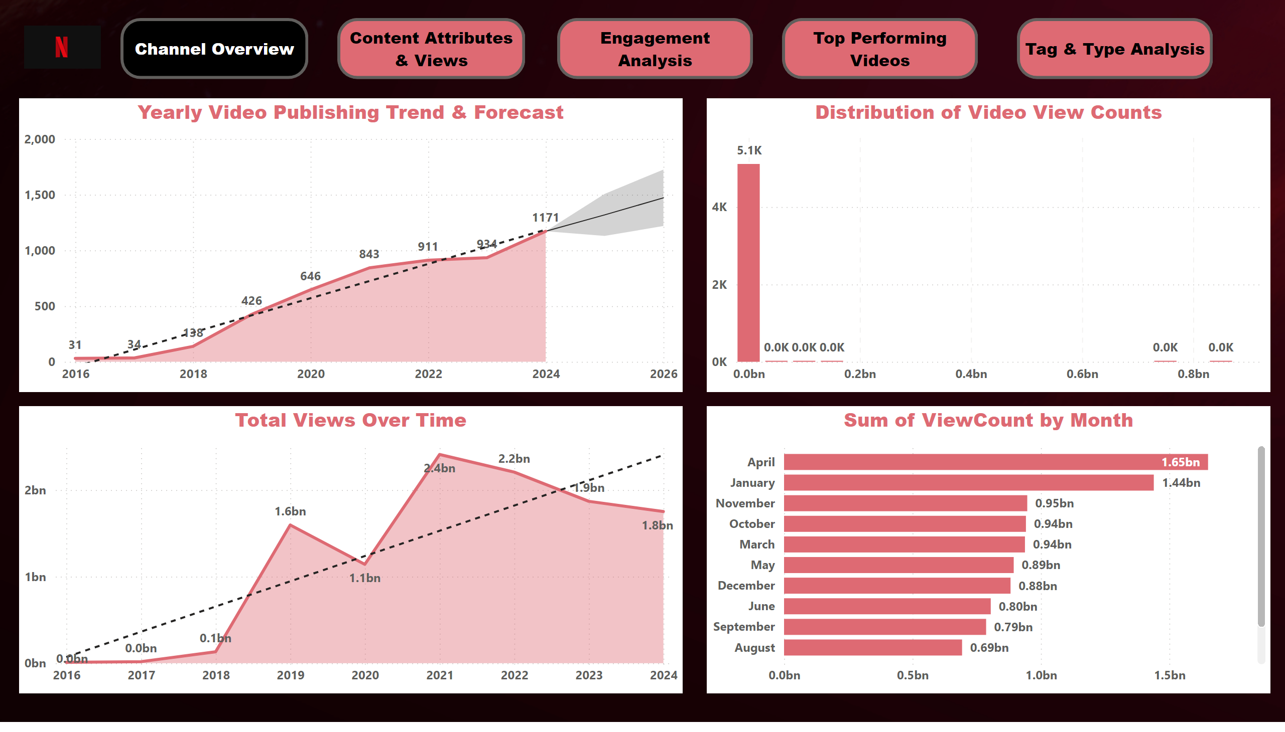
Channel Overview
Notes:
Yearly Video Publishing Trend & Forecast
No alt text provided
Total Views Over Time
No alt text provided
Distribution of Video View Counts
No alt text provided
barChart
No alt text provided
actionButton
No alt text provided
actionButton
No alt text provided
actionButton
No alt text provided
actionButton
No alt text provided
actionButton
No alt text provided
image
No alt text provided

Slide 6
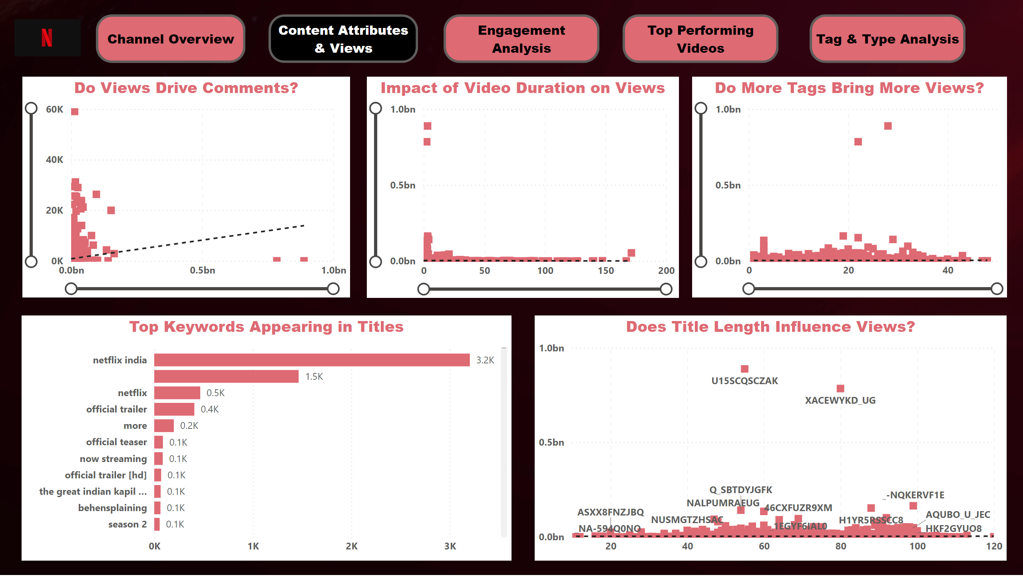
Content Attributes & Views
Notes:
Impact of Video Duration on Views
No alt text provided
Do More Tags Bring More Views?
No alt text provided
Does Title Length Influence Views?
No alt text provided
Top Keywords Appearing in Titles
No alt text provided
Do Views Drive Comments?
No alt text provided
actionButton
No alt text provided
actionButton
No alt text provided
actionButton
No alt text provided
actionButton
No alt text provided
actionButton
No alt text provided
image
No alt text provided

Slide 7
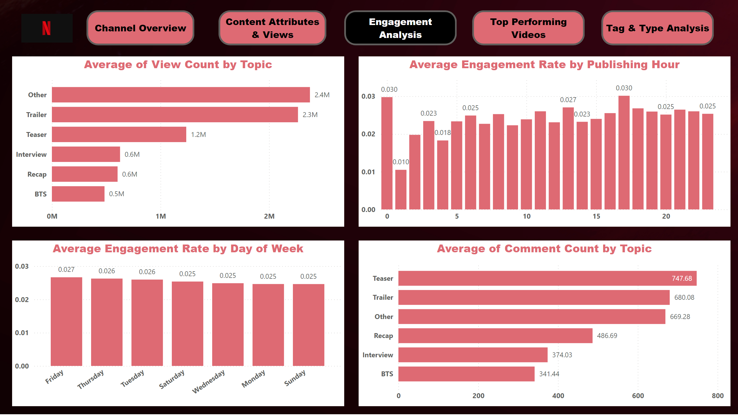
Engagement Analysis
Notes:
Average Engagement Rate by Day of Week
No alt text provided
clusteredBarChart
No alt text provided
clusteredBarChart
No alt text provided
Average Engagement Rate by Publishing Hour
No alt text provided
actionButton
No alt text provided
actionButton
No alt text provided
actionButton
No alt text provided
actionButton
No alt text provided
actionButton
No alt text provided
image
No alt text provided

Slide 8
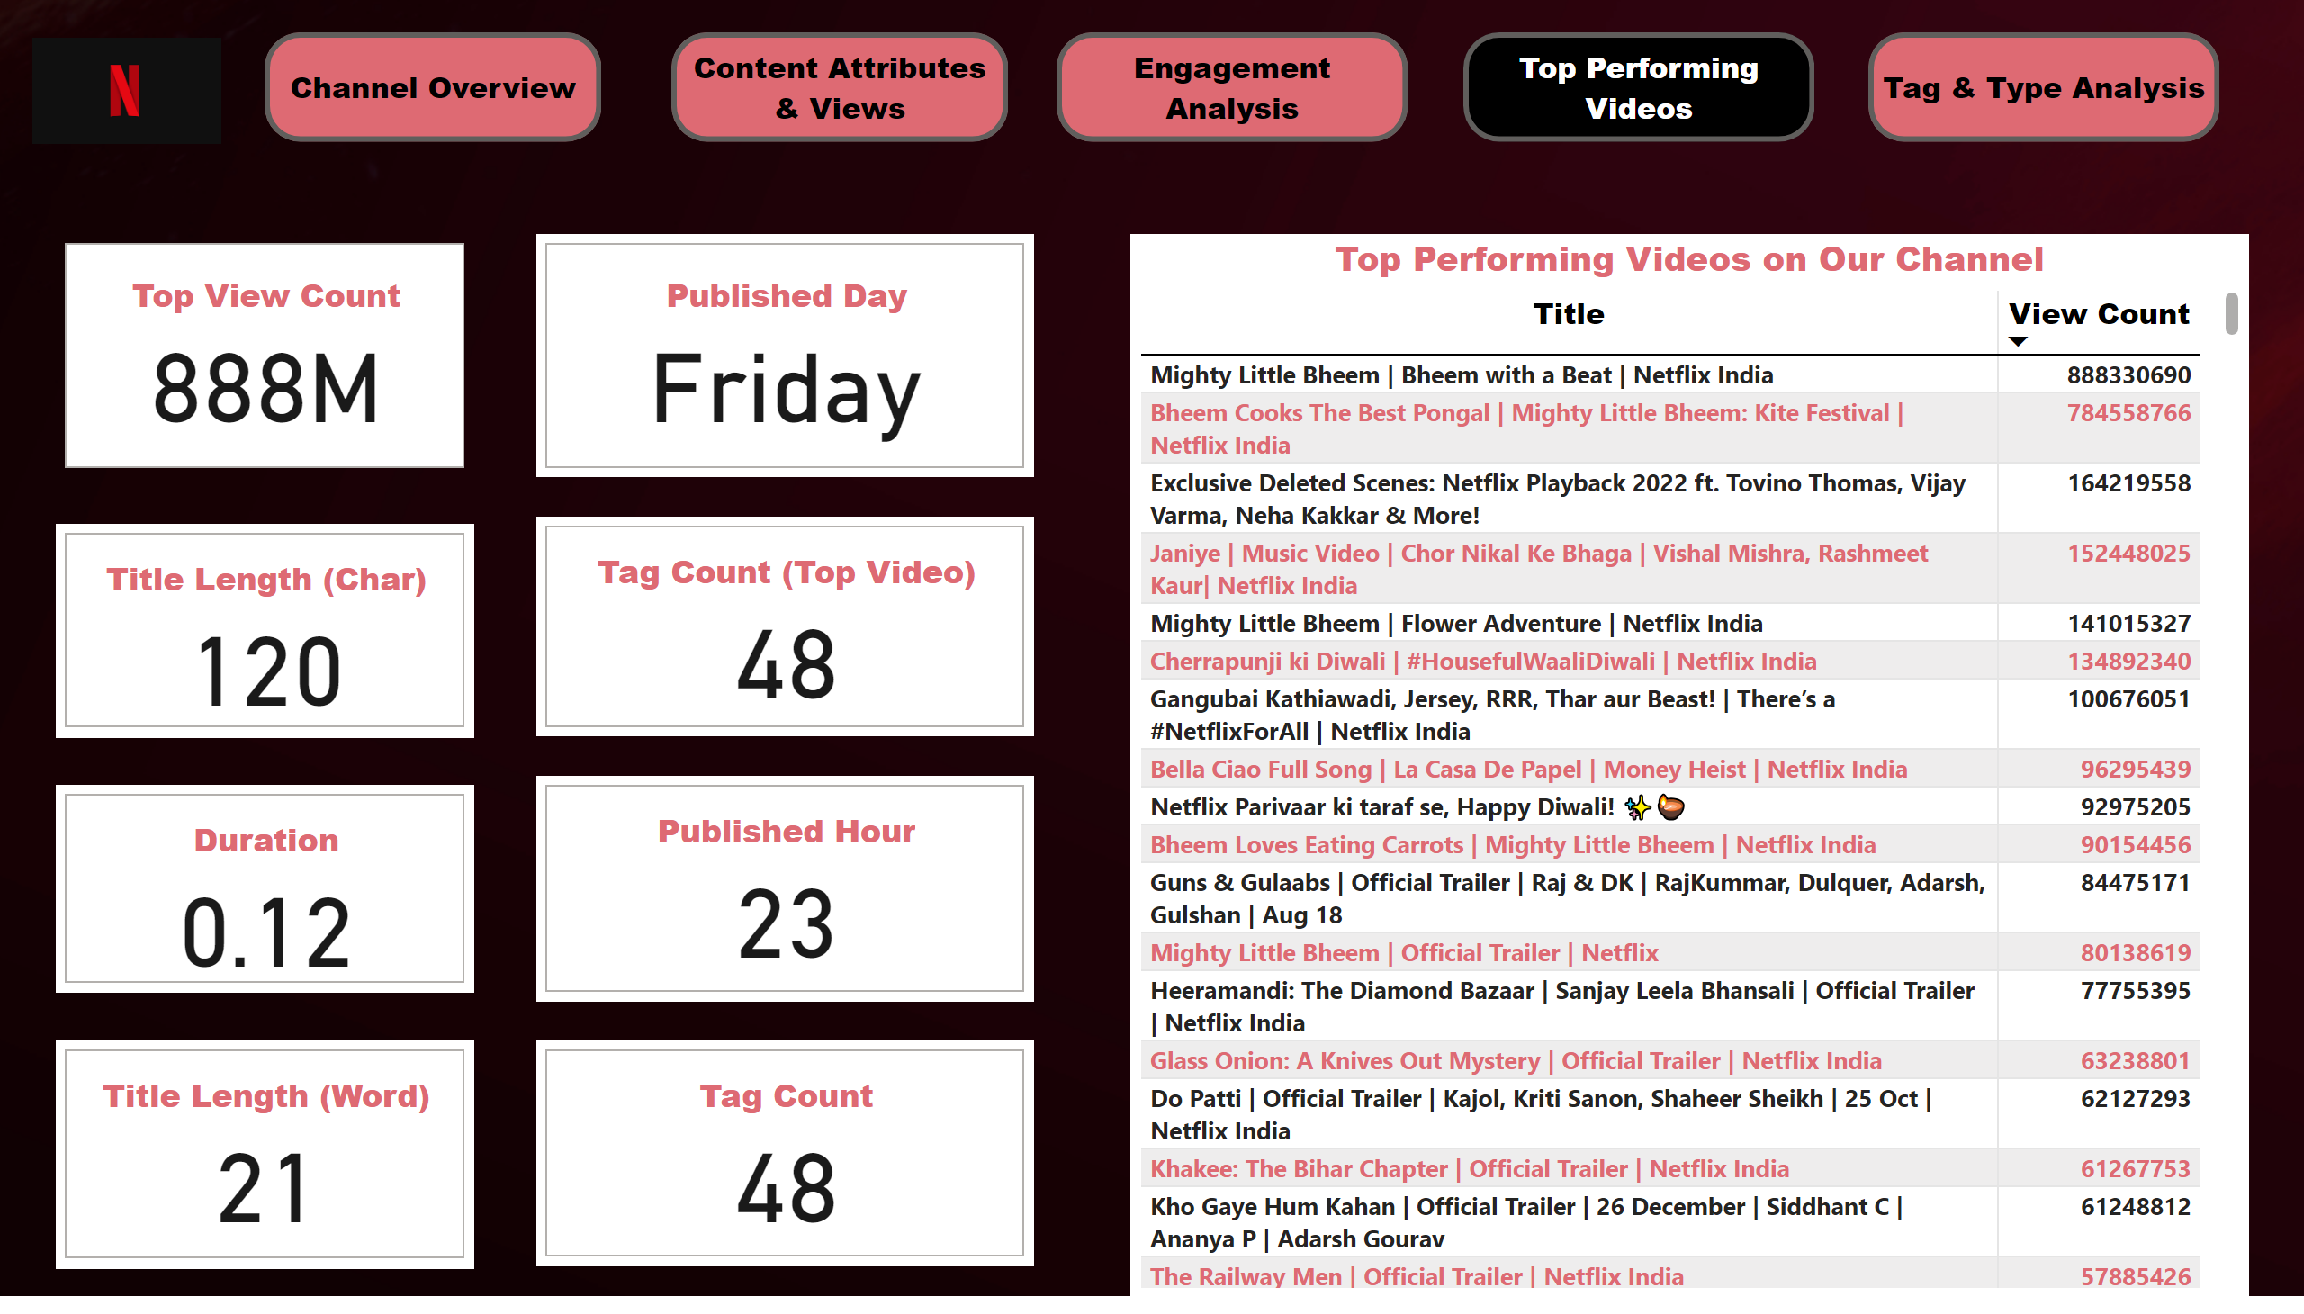
Top Performing Videos
Notes:
Top Performing Videos on Our Channel
No alt text provided
cardVisual
No alt text provided
cardVisual
No alt text provided
cardVisual
No alt text provided
cardVisual
No alt text provided
cardVisual
No alt text provided
cardVisual
No alt text provided
cardVisual
No alt text provided
cardVisual
No alt text provided
actionButton
No alt text provided
actionButton
No alt text provided
actionButton
No alt text provided
actionButton
No alt text provided
actionButton
No alt text provided
image
No alt text provided

Slide 9
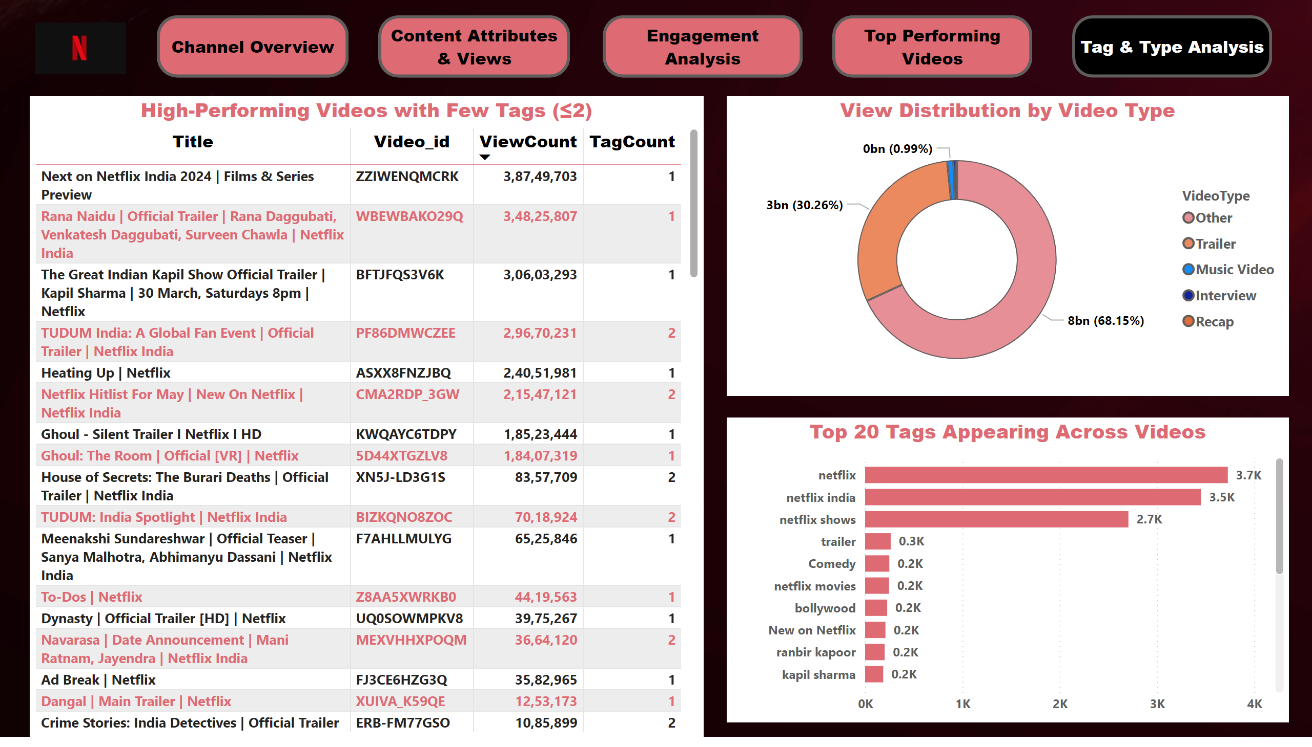
Tag & Type Analysis
Notes:
View Distribution by Video Type
No alt text provided
High-Performing Videos with Few Tags (≤2)
No alt text provided
Top 20 Tags Appearing Across Videos
No alt text provided
actionButton
No alt text provided
actionButton
No alt text provided
actionButton
No alt text provided
actionButton
No alt text provided
actionButton
No alt text provided
image
No alt text provided

